Slide 1
Event Loop in nodejs
Anju munoth

Slide 2
Asynchronous nature of nodejs
NodeJS is an asynchronous event-driven JavaScript runtime environment designed to build scalable network applications.
Asynchronous -Refers to all those functions in JavaScript that are processed in the background without blocking any other request.

Slide 3
Event Loop?
Node handles requests using an Event loop inside the NodeJS environment.
An event loop is an event-listener which functions inside the NodeJS environment and is always ready to listen, process, and output for an event.
An event can be anything from a mouse click to a keypress or a timeout.

Slide 4
Synchronous programming?
Synchronous programming ---Code runs in the sequence it is defined.
In a synchronous program, when a function is called and has returned some value, only then will the next line be executed.

Slide 5
Synchronous Programming
const listItems = function(items) {
items.forEach(function(item) {
console.log(item)
})
}
const items = ["Buy milk", "Buy coffee"]
listItems(items)
The output will look like this:
"Buy milk"
"Buy coffee"

Slide 6
Synchronous programming?
In this example, when the listItems(items) function is called, it will loop through the array of items.
console.log(item) function gets called first for the first item of the array and it prints "Buy milk".
Then again console.log(item) gets executed and this time it passes the second item of the array and prints "Buy coffee".
Function was executed in the sequence it was defined.

Slide 7
Asynchronous programming
Code that doesn't execute in sequence.
Functions are performed not according to the sequence they are defined inside a program but only when certain conditions are met.
For example, setTimeOut() performs a task after a delay of a certain predefined number of miliseconds.
Functions do not run line by line but only when they are required to run, irrespective of the function's declaration.
In this case, the function runs automatically after 3 seconds when all synchronous functions have been executed
setTimeOut(function(){ return( console.log("Hello World!") ) }, 3000)

Slide 8
Asynchronous programming
Asynchronous functions will run and execute only after all the synchronous functions have been executed. Until then, they will be processed in the background
But, how does NodeJS handle asynchronous functions in the background and run all synchronous functions first? All these mechanisms can be easily explained with the NodeJS event loop.

Slide 9
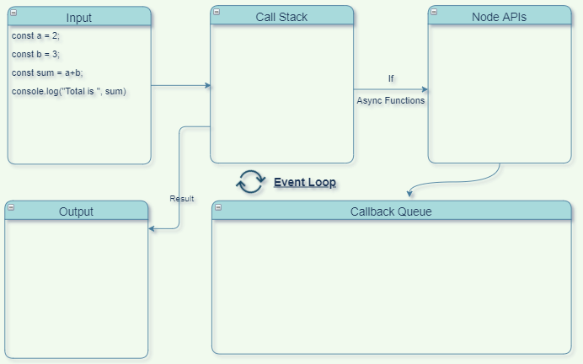
Synchronous programming

Slide 10
Synchronous programming
In the top-left corner, have a Node file that is going to get executed.
At the bottom left, have an output terminal for the program.
Then you have Call stack, Node APIs and Callback queue. All these together constitute the NodeJS environment.
For synchronous programming, you only need to focus on the call stack. This is the only part of the NodeJS environment that will be working in this case.
A callback stack is a data structure that you use to keep track of the execution of all functions that will run inside the program. This data structure has only one open end to add or remove top items.
When the program starts executing, it first gets wrapped inside an anonymous main() function. This is automatically defined by NodeJS. So main() gets pushed first to the callback stack.

Slide 11

Synchronous programming

Slide 12
Synchronous programming
Next, the variables a and b are created and their sum is stored in a variable sum. All these values are stored in memory.
Now, the console.log() is a function that is called and pushed inside the callback stack. It gets executed and you can see the output on the terminal screen.

Slide 13
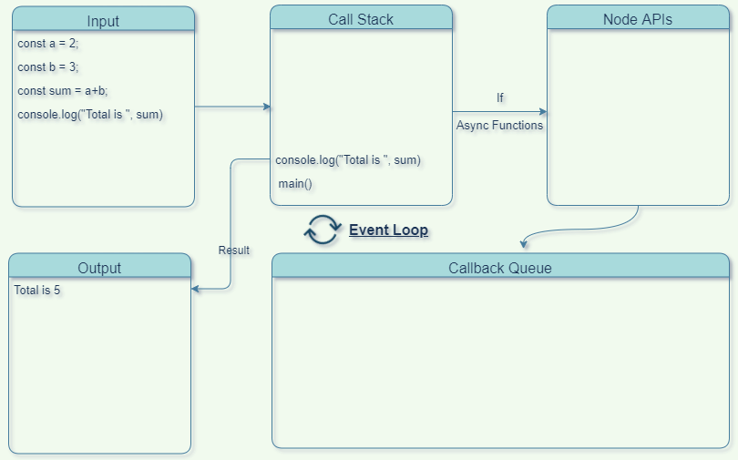
Synchronous programming

Slide 14
Synchronous programming
After this function gets executed, it is removed from the callback stack.
Then the main() is also removed as nothing is left to be called from the program.
This is how a synchronous program gets executed.

Slide 15
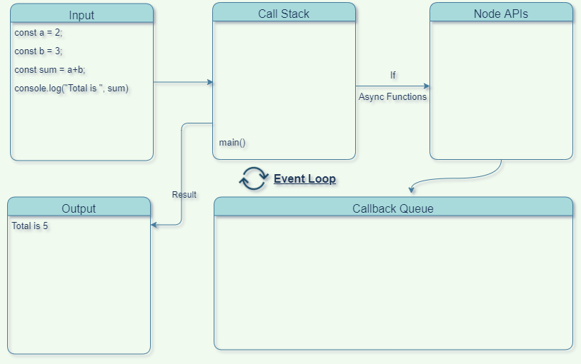
Synchronous programming

Slide 16
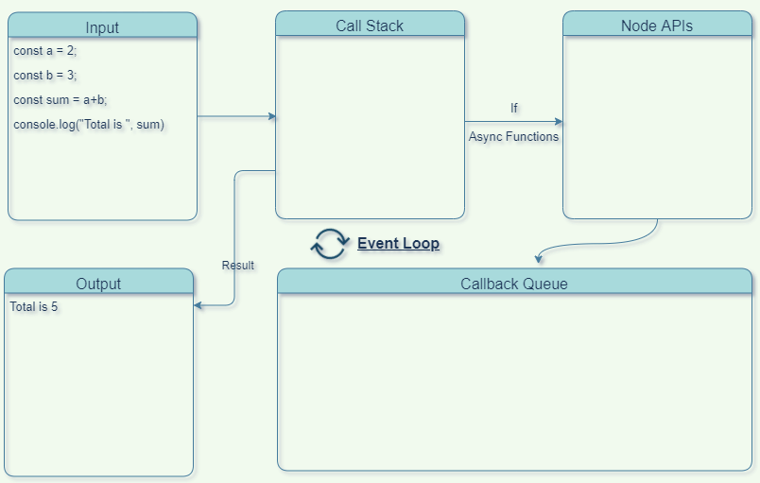
Synchronous programming

Slide 17
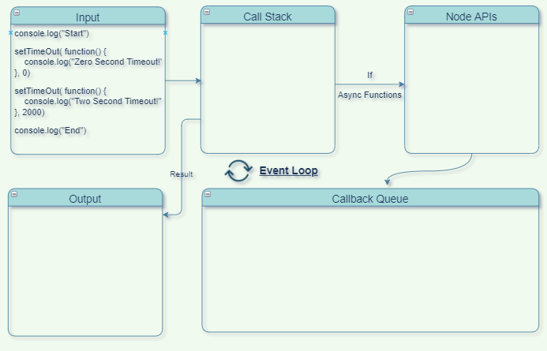
Asynchronous programming

Slide 18
Asynchronous programming
When the program starts executing, first the main() function gets added to the callback stack.
Then console.log("Start") is called and added to the callback stack.
After processing, the output is visible on the terminal and then it gets removed from the callback stack.

Slide 19
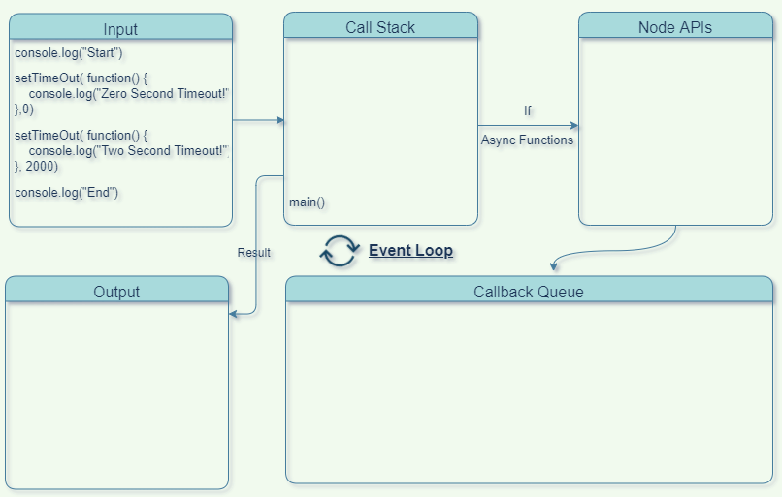
Asynchronous programming

Slide 20
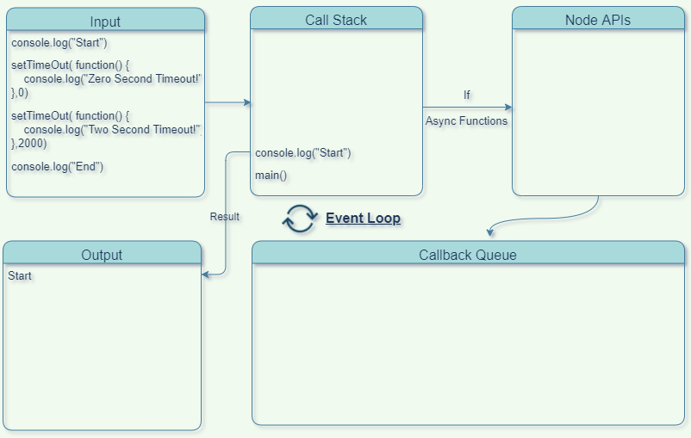
Asynchronous programming

Slide 21
Asynchronous programming
Now the next is the setTimeOut(...Zero...) function which gets added to the callback stack.
As this is an asynchronous function, it will not get processed in the callback stack.
It is then added from the callback stack to the Node APIs where an event is registered and a callback function is set to get processed in the background.

Slide 22
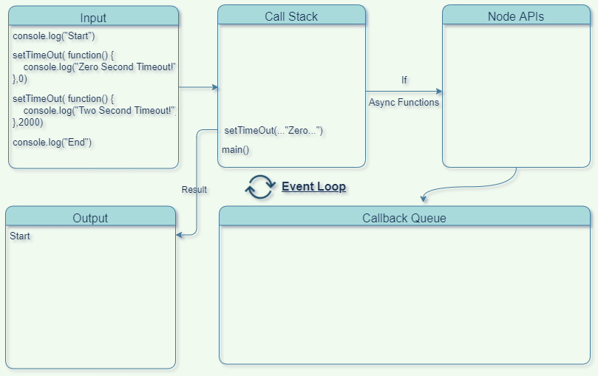
Asynchronous programming

Slide 23
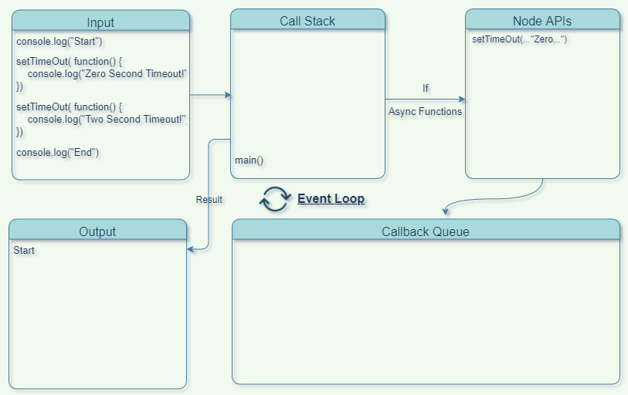
Asynchronous programming

Slide 24
Asynchronous programming
Next is the setTimeOut(...Two..) which also gets added to the Node API from the callback stack as it is an asynchronous function.
Then another callback function gets set to be processed after a 2 second timeout in the background.
Up until this point other functions can be performed.
This is called non-blocking behaviour where all the synchronous functions are processed and executed first and asynchronous functions are processed in the background while waiting their turn to get executed.

Slide 25
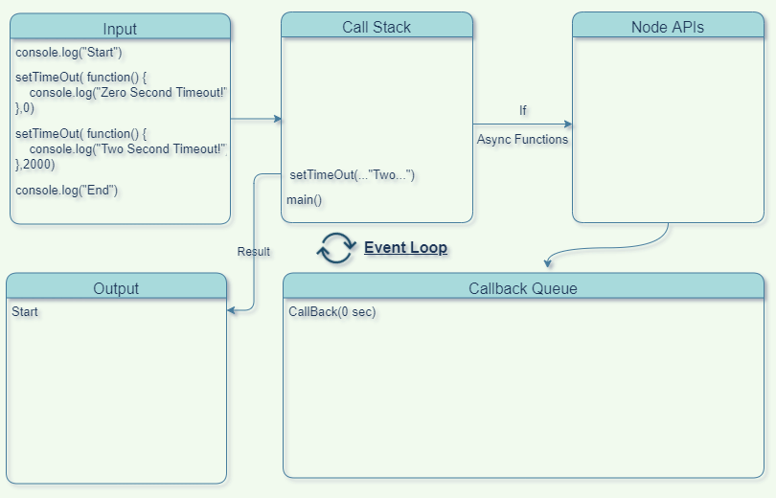
Asynchronous programming

Slide 26
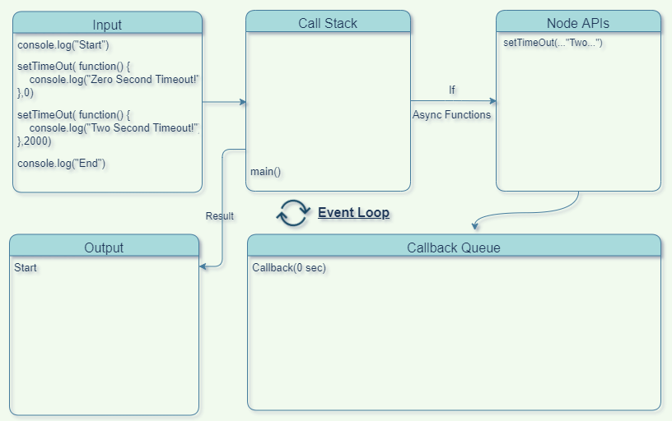
Asynchronous programming

Slide 27
Asynchronous programming
Next, the console.log("End") function is called at last in the callback stack and gets processed here.
Can see the output on the terminal.
Now, all the synchronous functions are processed, and main() is removed from the callback stack.
In the background, all the asynchronous functions get processed and their callbacks are stored in the callback queue.
The one which is processed first will be added first in the queue for execution in the callback stack.

Slide 28
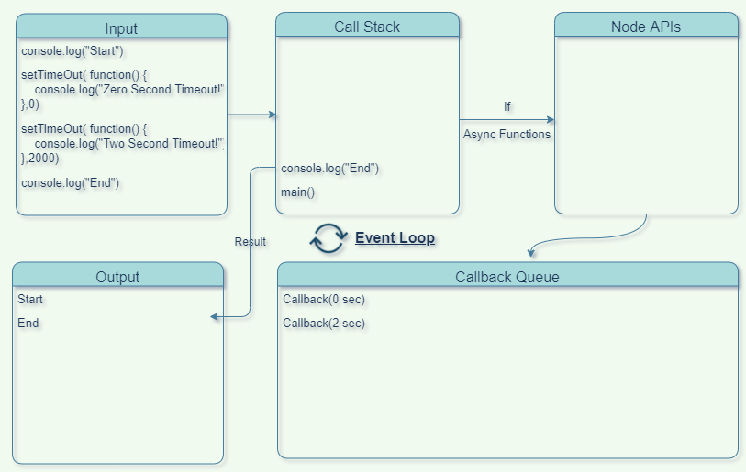
Asynchronous programming

Slide 29
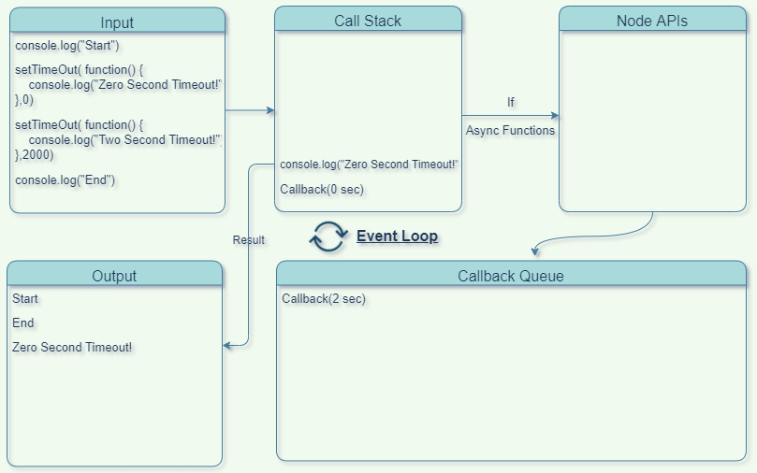
Asynchronous programming

Slide 30
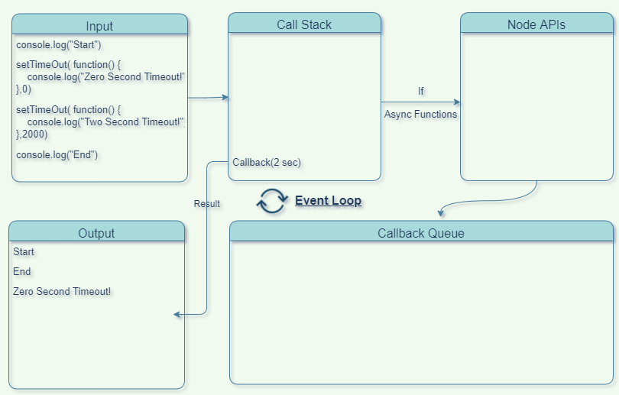
Asynchronous programming

Slide 31
Asynchronous programming
Asynchronous functions cannot run inside a callback stack until it gets emptied.
That means that after main() is removed from call stack, only then can all asynchronous functions start executing.
Now, one by one they are pushed to the callback stack using the event loop and finally get executed.
Each of the callback functions will print the value with the console.log() function getting called each time.

Slide 32
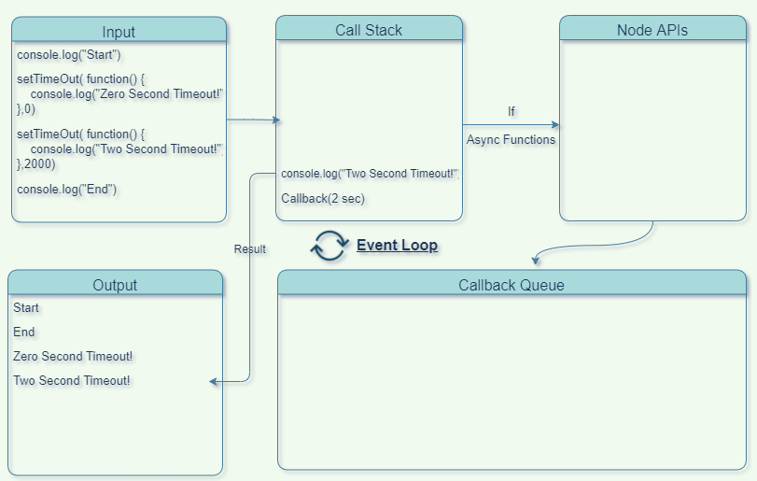
Asynchronous programming

Slide 33
Asynchronous programming
At last, these are also removed after being executed and now the callback stack is empty.

Slide 34
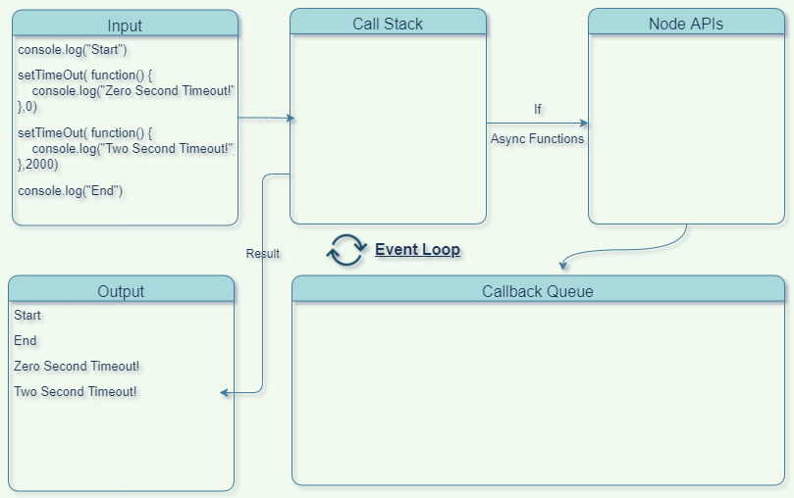
Asynchronous programming

Slide 35
Traditional Server
Traditional web-serving techniques use the thread model, meaning one thread for each request.
Since in an I/O operation the request spends most of the time waiting for it to complete, intensive I/O scenarios entail a large amount of unused resources (such as memory) linked to these threads.
Therefore the “one thread per request” model for a server doesn’t scale well.
When Ryan Dahl created Node in 2009 he argued that I/O was being handled incorrectly, blocking the entire process due to synchronous programming
Dahl argued that software should be able to multi-task and proposed eliminating the time spent waiting for I/O results to come back.
Instead of the thread model, he said the right way to handle several concurrent connections was to have a single-thread, an event loop and non-blocking I/Os.
For example, when you make a query to a database, instead of waiting for the response you give it a callback so your execution can run through that statement and continue doing other things. When the results come back you can execute the callback.

Slide 36
Nodejs
The event loop is what allows Node.js to perform non-blocking I/O operations despite the fact that JavaScript is single-threaded.
The loop, which runs on the same thread as the JavaScript code, grabs a task from the code and executes it. If the task is async or an I/O operation the loop offloads it to the system kernel, like in the case for new connections to the server, or to a thread pool, like file system related operations.
The loop then grabs the next task and executes it.
Since most modern kernels are multi-threaded, they can handle multiple operations executing in the background.
When one of these operations completes (this is an event), the kernel tells Node.js so that the appropriate callback (the one that depended on the operation completing) may be added to the poll queue to eventually be executed.

Slide 37
Node keeps track of unfinished async operations, and the event loop keeps looping to check if they are finished until all of them are.
To accommodate the single-threaded event loop, Node.js uses the libuv library, which, in turn, uses a fixed-sized thread pool that handles the execution of some of the non-blocking asynchronous I/O operations in parallel.
The main thread call functions post tasks to the shared task queue, which threads in the thread pool pull and execute.
Inherently non-blocking system functions such as networking translate to kernel-side non-blocking sockets, while inherently blocking system functions such as file I/O run in a blocking way on their own threads.
When a thread in the thread pool completes a task, it informs the main thread of this, which in turn, wakes up and executes the registered callback.

Slide 38
Features of Event Loop:
Event loop is an endless loop, which waits for tasks, executes them and then sleeps until it receives more tasks.
The event loop executes tasks from the event queue only when the call stack is empty i.e. there is no ongoing task.
The event loop allows us to use callbacks and promises.
The event loop executes the tasks starting from the oldest first.

Slide 39
console.log(1);
console.log(2);
console.log(3);
// Output:
// 1
// 2
// 3

Slide 40
console.log(1);
setTimeout(function foo(){
console.log(2);
}, 0);
console.log(3);
// Output:
// 1
// 3
// 2
1. console.log(1) method is called and placed on the call stack and being executed.
2. setTimeout method is called and placed on the call stack and being executed, this execution creates a new call to setTimeout Web Api for 0 milliseconds, when it finishes (right away, or if to be more precise then it would be better to say “as soon as possible”) the Web Api moves the call to the Callback Queue.
3. console.log(3) method is called and placed on the call stack and being executed.
4. The Event Loop sees that the Call Stack is empty and takes out “foo” method from the Callback Queue and places it in the Call Stack, then console.log(2) is being executed.

Slide 42
console.log(1);
setTimeout(function foo() {
console.log(‘foo’);
}, 3500);
setTimeout(function boo() {
console.log(‘boo’);
}, 1000);
console.log(2);
// Output:
// 1
// 2
// 'boo'
// 'foo'

Slide 43
console.log(1);
setTimeout(function foo() {
console.log(‘foo’);
}, 6500);
setTimeout(function boo() {
console.log(‘boo’);
}, 2500);
setTimeout(function baz() {
console.log(‘baz’);
}, 0);
for (const value of [‘A’, ‘B’]) {
console.log(value);
}
function two() {
console.log(2);
}
two();
// Output:
// 1
// 'A'
// 'B'
// 2
// 'baz'
// 'boo'
// 'foo'

Slide 45
Macro-Tasks (Task Queue) & Micro-Tasks
Two types of queues. 1. macro-task queue (or task queue). 2. micro-task queue.
Common Macro-Tasks are setTimeout, setInterval, and setImmediate.
Common Micro-Task are process.nextTick and Promise callback.

Slide 46
Macro-Tasks (Task Queue) & Micro-Tasks
Order of execution
All functions that are currently in the call stack get executed and then they get popped off the call-stack.
When the call stack is empty, all queued-up micro-tasks are popped onto the call-stack one by one and get executed, and then they get popped off the call-stack.
When both the call-stack and micro-task queue are empty, all queued-up macro-tasks are popped onto the call-stack one by one and get executed, and then they get popped off the call-stack.
Note : event loop should process the micro-task queue entirely, after processing one macro-task from the macro-task queue.

Slide 47
console.log(1);
setTimeout(function foo() {
console.log(‘foo’);
}, 0);
Promise.resolve()
.then(function boo() {
console.log(‘boo’);
});
console.log(2);
// Output:
// 1
// 2
// 'boo'
// 'foo'
console.log(1) method is called and placed on the call stack and being executed.
SetTimeout is being executed, the console.log(‘foo’) is moved to SetTimeout Web Api, and 0 milliseconds afterward it moves to Macro-Task Queue.
Promise.resolve() is being called, it is being resolved and then .then() method is moved to Micro-Task queue.
console.log(2) method is called and placed on the call stack and being executed.
Event Loop sees that the call-stack is empty, it takes firstly the task from Micro-Task queue which is the Promise task, puts the console.log(‘boo’) on the call-stack and executes it.
Event Loop sees that the call-stack is empty, then it sees that the Micro-Task is empty, then it takes the next task from the Macro-Task queue which is the SetTimeout task, puts the console.log(‘foo’) on the call-stack and executes it.

Slide 49
Event Loop lower level Explained
When Node.js starts, it initializes the event loop, processes the provided input script (or drops into the REPL) which may make async API calls, schedule timers, or call process.nextTick(), then begins processing the event loop.
Diagram(next slide) shows a simplified overview of the event loop’s order of operations.
Each box will be referred to as a “phase” of the event loop

Slide 50
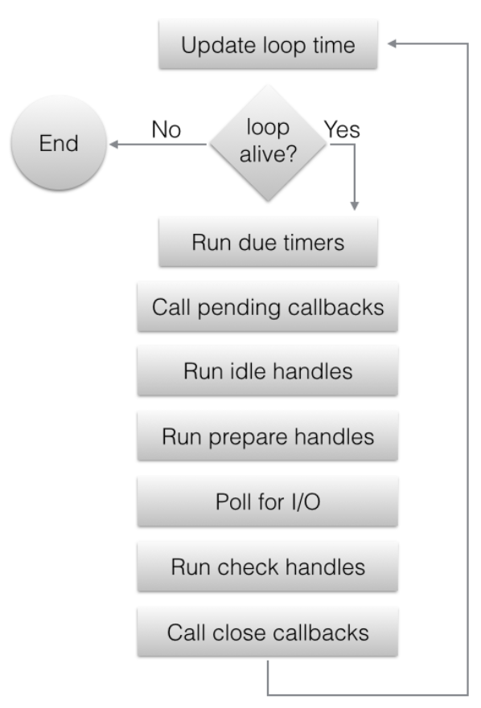

Slide 51
Event Loop
Each phase has a FIFO queue of callbacks to execute
While each phase is special in its own way, generally, when the event loop enters a given phase, it will perform any operations specific to that phase, then execute callbacks in that phase’s queue until the queue has been exhausted or the maximum number of callbacks has executed.
When the queue has been exhausted or the callback limit is reached, the event loop will move to the next phase, and so on.

Slide 52
Phases Overview
Timers: this phase executes callbacks scheduled by setTimeout() and setInterval().
Pending callbacks: executes I/O callbacks deferred to the next loop iteration.
Idle, Prepare: only used internally.
Poll: retrieve new I/O events; execute I/O related callbacks (almost all with the exception of close callbacks, the ones scheduled by timers, and setImmediate()); node will block here when appropriate.
Check: setImmediate() callbacks are invoked here.
Close callbacks: some close callbacks, e.g. socket.on('close', ...).

Slide 53
Phases Overview
Step 1: The event loop updates the loop time to the current time for the current execution.
Step 2: Micro-Queue is executed.
Step 3: A task from the Timers phase is executed.
Step 4: Checking if there is something in the Micro-Queue and executes the whole Micro-Queue if there is something.
Step 5: Returns to Step 3 until the Timers phase is empty.
Step 6: A task from the Pending Callbacks phase is executed.
Step 7: Checking if there is something in the Micro-Queue and executes the whole Micro-Queue if there is something.
Step 8: Returns to Step 6 until the Pending Callbacks phase is empty.
And then Idle… Micro-Queue … Poll … Micro-Queue … Check … Micro-Queue … Close CallBacks and then it starts over.

